Slide 1
Processor implementation on Altera DE2 Development and Education Board
V. Mitić, M. Petković, D. Todorović ¹, Volker Zerbe ²
1 - University of Nis, Faculty of Electronic Engineering; 2 - University of Applied Sciences, Erfurt

Slide 2
Agenda
Introducing to:
Hardware
Altera Developement and Education Boards
FPGAs
Software
Programming tools for FPGAs
VHDL

Slide 3
Introduction
Technology
Altera Quartus II
DE2 Development and Education Board

Slide 4
DE2 Development and Education Board

Slide 5
Elements of the board used
Elements | Role
Switches SW10 TO SW18 | NUMBER A
Switches SW0 TO SW7 | NUMBER B
Swithes SW8 and SW9 | OPERATION SELECTOR
Pushbuttons KEY0 TO KEY 3 | OPERATION SELECTOR, TRIGGER
LEDs LEDR0 TO REDL8 | RESULT (in binary numeral system)
Displays HEX0 TO HEX2 | RESULT (in decimal numeral system)

Slide 6
Design, fabrication and code
Processor Block Diagram/Schematic file
Operations symbols
8bitadder, 8bitsupstract, 8bitand, 8bitor, 8bitnot, 8bitxor, 8bitnand, 8bitnor
Multiplexer symbols
Multiplexernot, Multiplexer, Multiplexer2, Multiplexerrez
HEXdec symbol
Converter symbol

Slide 7
Input numbers
Operations
HEXdec
Multiplexers
Output Displays
Input pushbuttons
Output LEDs
Input selector switches
Processor Block
Diagram/Schematic file

Slide 8
Operations symbols
Symbol name | Role | Number of I/O pins
8bitadder | Addition of two numbers | 8/9
8bitsupstract | Substraction of two numbers | 8/9
8bitand | Logical AND | 8/8
8bitor | Logical OR | 8/8
8bitnot | Logical NOT | 8/8
8bitxor | Logical XOR | 8/8
8bitnand | Logical NAND | 8/8
8bitnor | Logical NOR | 8/8

Slide 9
Operations symbols
8bitadder Addition is done with the use of two symbols: halfadder and fullader.
Symbol name | Input pins | Output pins
HALFADDER | A,B | SUM,CARRY
FULLADDER | A,B,CARRY_IN | SUM,CARRY

Slide 10
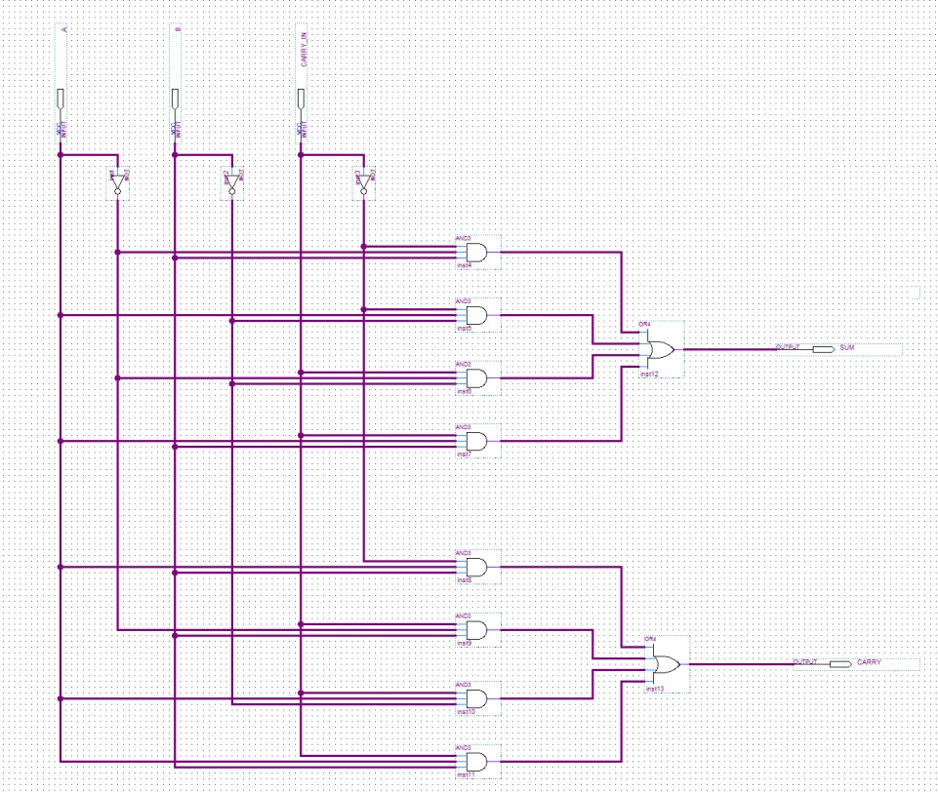
HALFADDER
FULLADDER

Slide 11
Multiplexer symbols
Symbol name | Number of input pins | Number of output pins | Number of selector pins
Multiplexernot | 16 | 8 | 2
Multiplexer | 34 | 9 | 4
Multiplexer2 | 32 | 8 | 4
Multiplexerrez | 17 | 9 | 2

Slide 12
Multiplexernot
There are two 8-bit numbers on the input and two selector pins (SEL0-SEL1)
There is one 8-bit number on the output.
The output number is eaqual to one of the input numbers depending of the selector pins.

Slide 13
HEXdec symbol
This symbol performs conversion of a binary number, which is at the input, into a decimal number which is displayed on the 7- segment displays.
There are 9 input and 49 output pins.
The conversion from binary to decimal numeral system is implemented using converter symbol.
Representation of a number onto 7-segment display is done with symbols HEX0-HEX9.

Slide 14
Converter symbol
This symbol is a graphical representation of converter.vhd file that is written in VHDL code.
This symbol does not only convert the number, but also it “determines” the distribution of digits in the decimal number.
There are 9 input pins and 29 output pins.
All commands are executed in a process (named CONVERSION) because they have to be executed sequentially (one by one).

Slide 15
Results in brief
Aquired knowlage about:
Elements and posibilities of DE2 Development and Education Board
Basics of VHDL (via converter.vhd)
Altera Quartus tools for synthesis and simulation
FPGAs

Slide 16
Conclusion
DE2 Developement and Education board advantages
FPGA advantages
VHDL advantages
Implementation: from lab demos to ESA projects

Slide 17
Thank you for your attention!
Any questions?

